Slide 1
Phase 2: Data Understanding & Exploratory Analysis
Empirical inspection, statistical distributions, correlation modeling, and preprocessing of gym workout records.
Gym Exercise Tracking Dataset

Slide 2
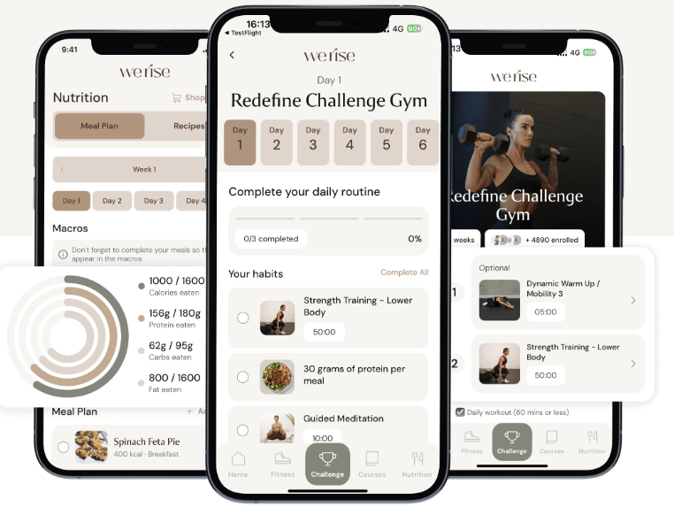
1. BRIEF DESCRIPTION OF DATA
Dataset Provenance & Scope
DATA SOURCE
Kaggle / GitHub Repository
https://www.kaggle.com/datasets/valakhorasani/gym-members-exercise-dataset
COLLECTION CONTEXT
Fitness Center Member Tracking
Aggregated biometric and physiological workout metrics.
CORE OBJECTIVE
Energy Expenditure Prediction
Exploratory baselining for caloric burn modeling and training patterns.

Slide 3
2. DIMENSIONS & TARGET ARCHITECTURE
Structural Profile & Target Variable
973
15
13 / 2
Total Member Records
Observed Features
Numeric vs. Categorical
TARGET CLASS IDENTIFICATION
CATEGORICAL DATA
Calories_Burned
Gender & Workout_Type
Continuous numerical regression target indicating total energy output per exercise session.
Gender (Male / Female) and Workout Type (Cardio, HIIT, Strength, Yoga) serve as key groupings.
NUMERICAL DATA
Age, Weight, Height, Max_BPM, Avg_BPM,Resting_BPM, Session_Duration, Fat_Percentage, Water_Intake, Workout_Frequency, Experience_Level, BMI

Slide 4




2. DATA QUALITY & PREPROCESSING
Detected Anomalies & Cleansing Steps
Zero Missing Values
Zero Duplicates
Unit Transformation
Z-Score Outliers
Zero null entries across all 15 columns.
973 unique tracking records confirmed.
Added pounds and inches for modeling.
Identified extreme points exceeding |Z| > 3.

Slide 5
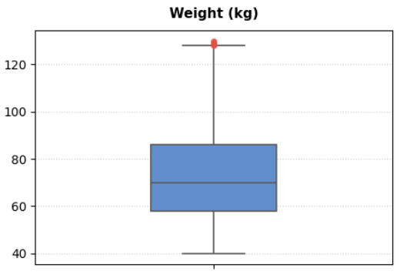
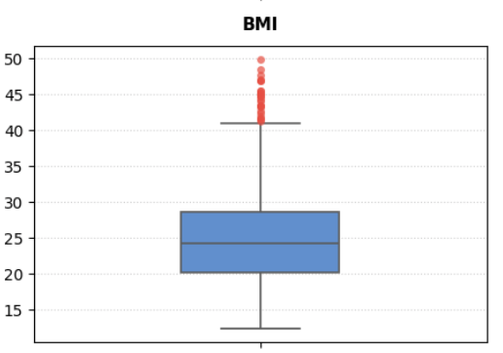
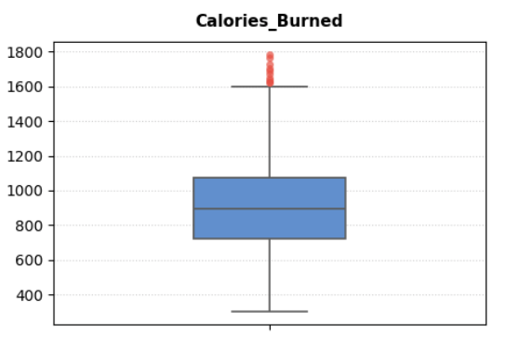
2. DATA QUALITY & PREPROCESSING
Outliers Using Boxplots

Slide 6
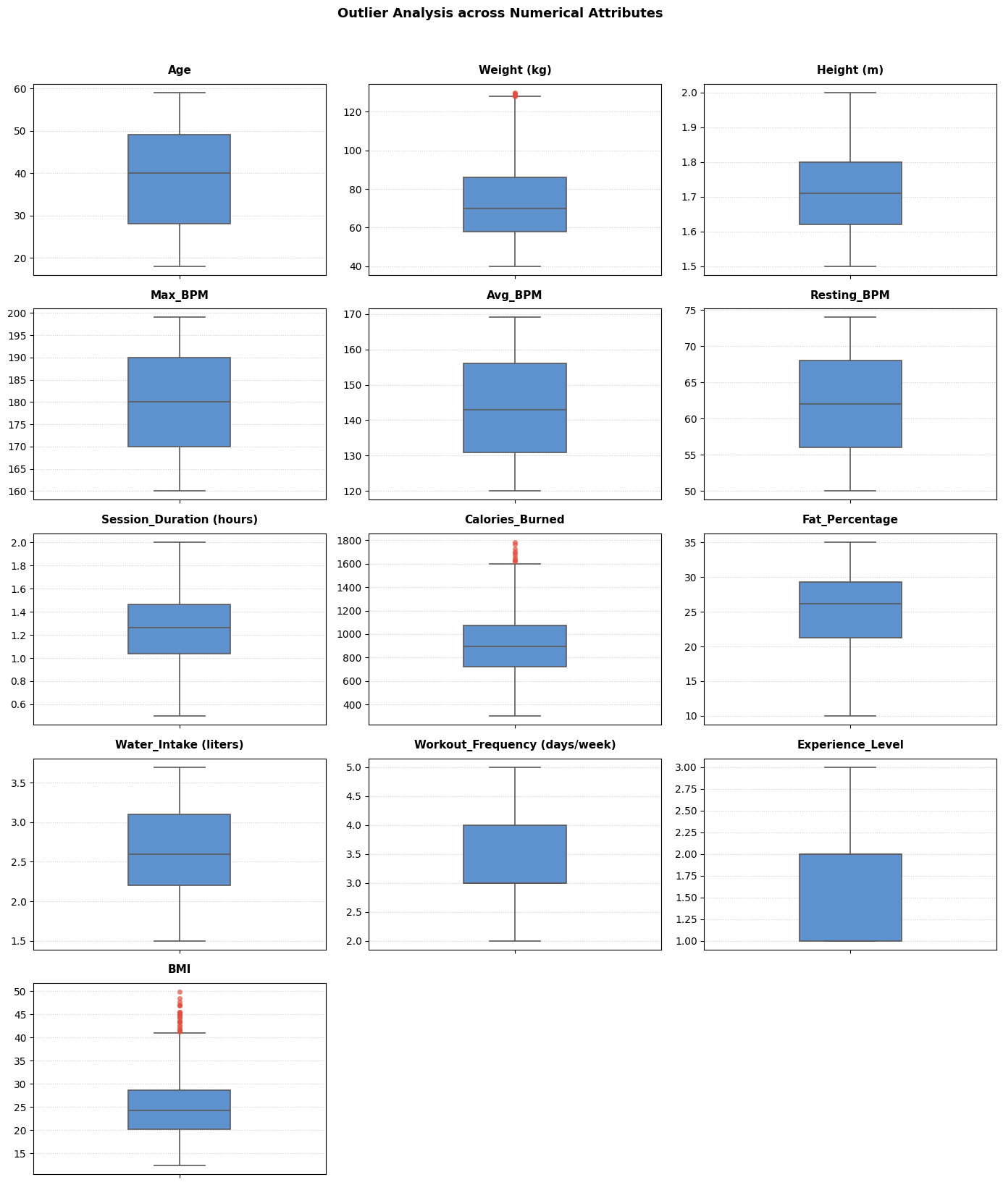
2. DATA QUALITY & PREPROCESSING
Outliers Using Boxplots

Slide 7
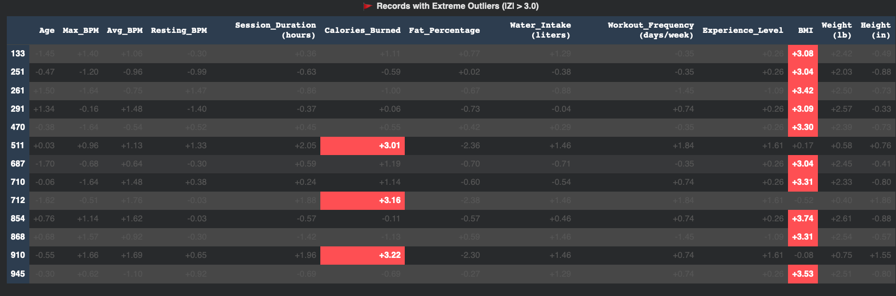
2. DATA QUALITY & PREPROCESSING
Outliers Using Z-scores

Slide 8
2. STATISTICAL ANALYSIS
Parametric Summary of Key Attributes
Feature Attribute | Data Type | Min | Max | Mean ± Std | Observed Spread
Calories_Burned (Target) | Float64 | 303.00 | 1783.00 | 905.42 ± 272.64 | Broad continuous range
Session_Duration (hours) | Float64 | 0.50 | 2.00 | 1.26 ± 0.34 | Uniform exercise window
Avg_BPM | Int64 | 120 | 169 | 143.77 ± 14.35 | Cardiovascular exertion
Fat_Percentage | Float64 | 10.0% | 35.0% | 24.98% ± 6.26% | Realistic body composition
Workout_Frequency | Int64 | 2 days | 5 days | 3.32 ± 0.91 | Days logged per week

Slide 9
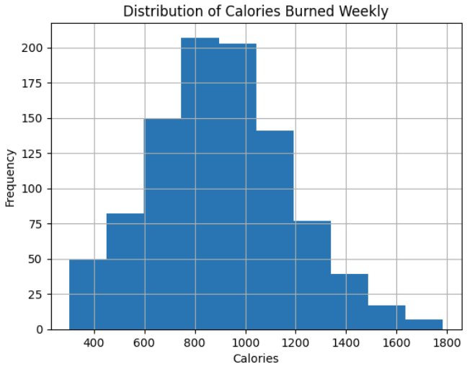
3. PLOTS & HISTOGRAMS
Target Distribution: Calories Burned
Binned histogram of Calories Burned across 10 equal frequency intervals (200 kcal to 1,800 kcal).
Normal distribution shape centered near 900 kcal
Slight positive right skew toward endurance workouts

Slide 10
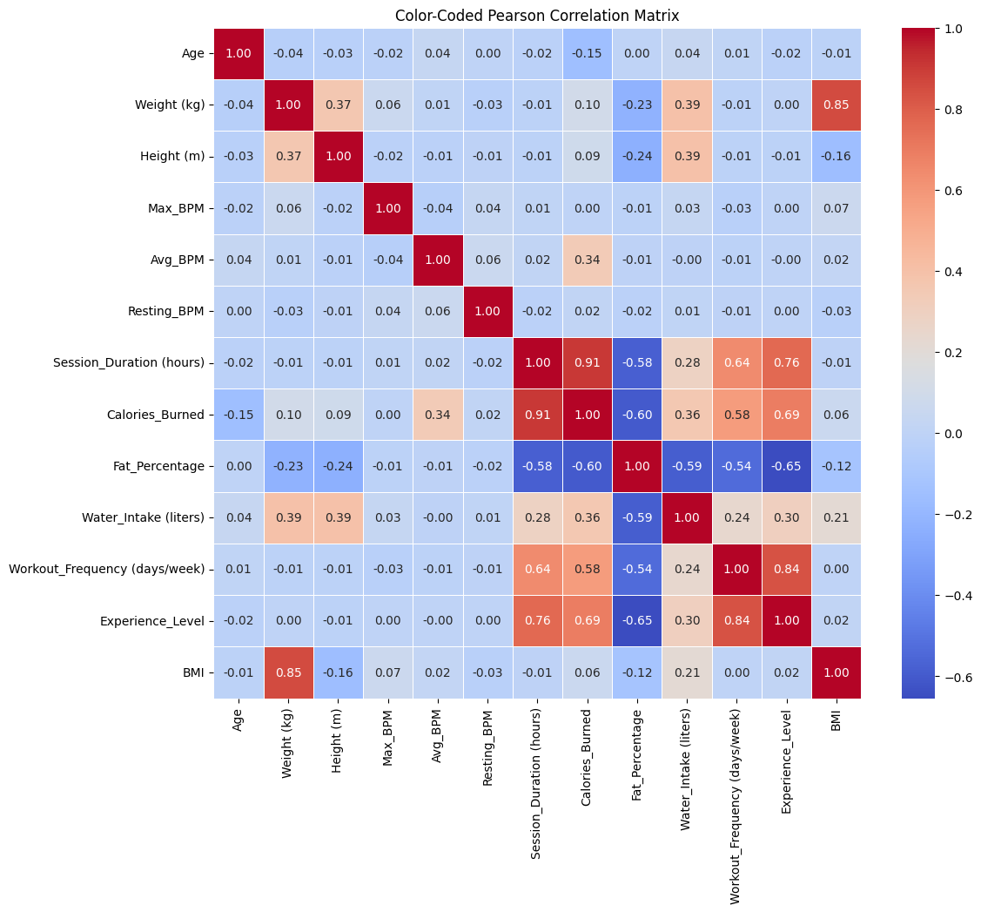
4. CORRELATION ANALYSIS
Pearson Correlation with Target (Calories Burned)

Slide 11
4. CORRELATION ANALYSIS
Pearson Correlation with Target (Calories Burned)
Session_Duration
+0.91
Experience_level
+0.69
Workout_frequency
+0.58
Average_BPM
+0.34
Fat_Percentage
-0.60
Key Takeaway: Workout duration is the primary linear predictor (r = 0.91), followed by cardiovascular intensity (Experience_level = 0.69).

Slide 12
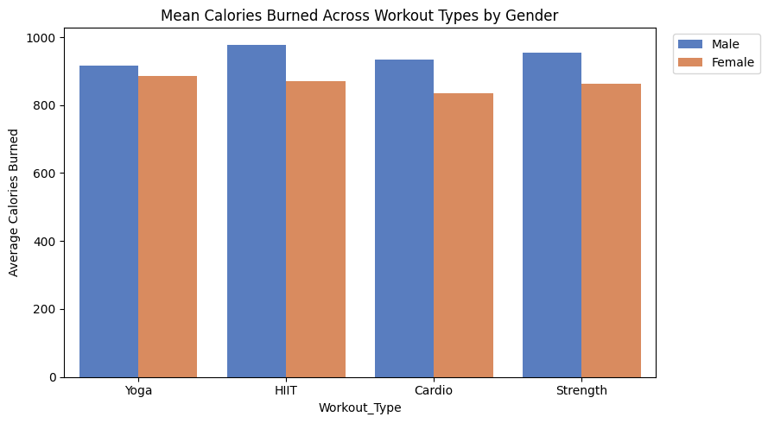
5. SCATTER PLOTS & MULTIVARIABLE ANALYSIS
Workout Type & Gender Interactions
Caloric Burn by Workout
HIIT Workouts: Average calories burn (~980 kcal).
Strength Training: Average calories burn (~970 kcal).
Cardio Sessions: Average calories burn (~960 kcal).
Yoga Classes: Average calories burn (~900 kcal).

Slide 13
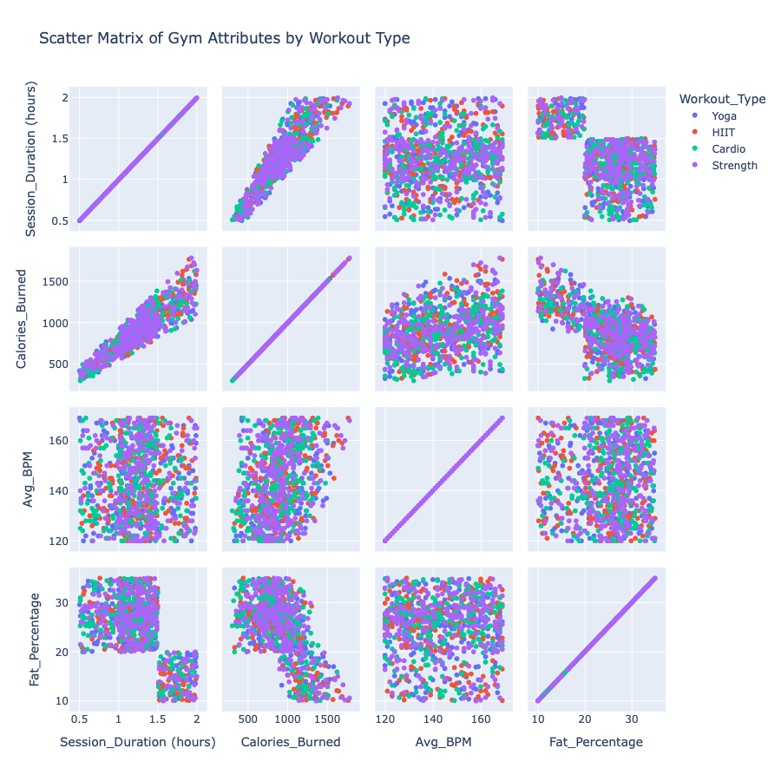
5. SCATTER PLOTS & MULTIVARIABLE ANALYSIS
Workout Type Vs (Session_Duration, Calories_Burned, Avg_BPM, Fat_Percentage)
Scatter Matrix Insights
Duration vs Calories: Distinct tight linear upward slope.
Heart Rate Clusters: Clear separation between HIIT and Yoga.
Gender Differences: Slight divergence driven by body mass scale.
Fat % Inverse Slope: Higher body fat correlates with lower BPM peak.

Slide 14
5. FEATURE ENGINEERING: DISCRETIZATION
Equal-Frequency Binning for Calories Burned and Fat Percentage
Equal-Frequency (pd.qcut) Calories Burned
Equal-Frequency (pd.qcut) Fat percentage
Divides into 4 quartiles with equal record counts.
Divides into 4 quartiles with equal record counts.
Q1: 302 - 720
245 members
Q1: 29-35
239 members
Q2: 720 - 893
242 members
Q2: 26 - 29
245 members
Q3: 893 - 1076
243 members
Q3: 21 -26
236 members
Q4: 1076 - 1783
243 members
Q4: 9 - 21
253 members

Slide 15
Reference
https://healthyhabitsexplorer.com/my-one-year-journey-with-the-werise-app-by-senada-greca/

Slide 16
Questions?

